Slide 1
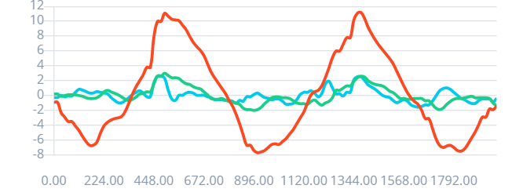
Sample accelerometer for 2 seconds
Edge Impulse library
...
Feature extraction:
RMS and Power Spectral Density (PSD)
Model
P(left-right)
P(up-down)
P(circle)
P(idle)
33x features
...
62.5 Hz sampling for 2 seconds with 3 axes = 375 values
375 raw values
P(left-right)
P(up-down)
P(circle)
P(idle)
= 0.9143
= 0.0032
= 0.0581
= 0.0244

Slide 2
if (p_left_right > 0.5) {
// Do stuff }
if (p_up_down > 0.5) {
// Do some things }
if (p_circle > 0.8) {
// And now for something completely different }

Slide 3
Sample accelerometer for 2 seconds
Edge Impulse library
...
Feature extraction:
RMS and Power Spectral Density (PSD)
Model
P(left-right)
P(up-down)
P(circle)
P(idle)
33x features
...
62.5 Hz sampling for 2 seconds with 3 axes = 375 values
375 raw values

Slide 4
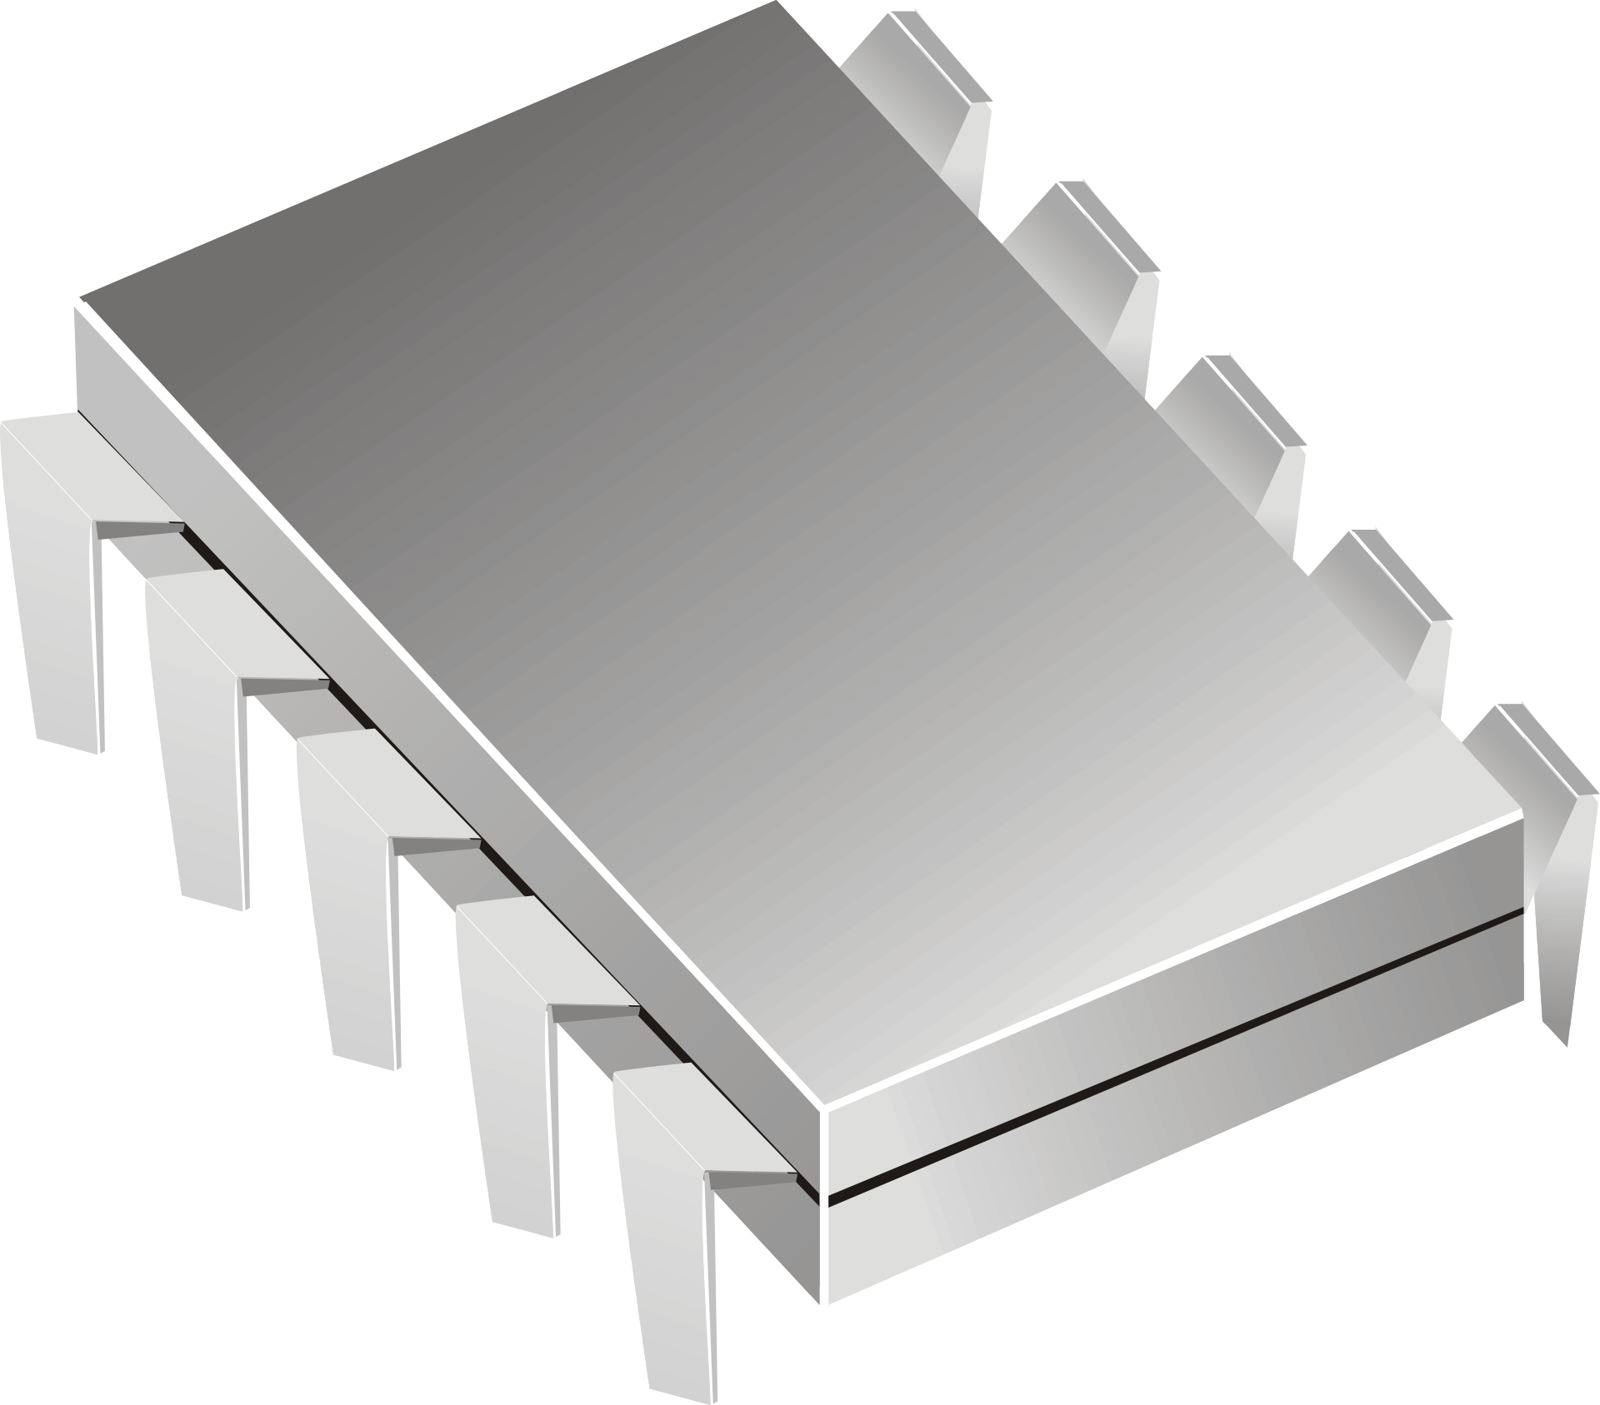

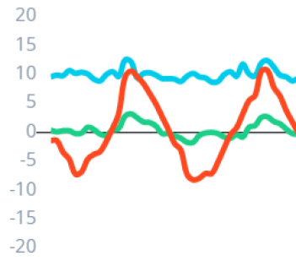
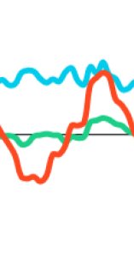
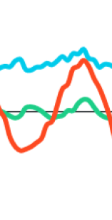
Raw buffer (3 x 125)
Raw buffer (3 x 125)
Raw buffer (3 x 125)
Sample accelerometer every 16 ms (62.5 Hz)
Timer interrupt
Real-time operating system (RTOS) task
Direct memory access (DMA)
Feature extraction:
RMS and Power Spectral Density (PSD)
Model
P(left-right)
P(up-down)
P(circle)
P(idle)

